Slide 1


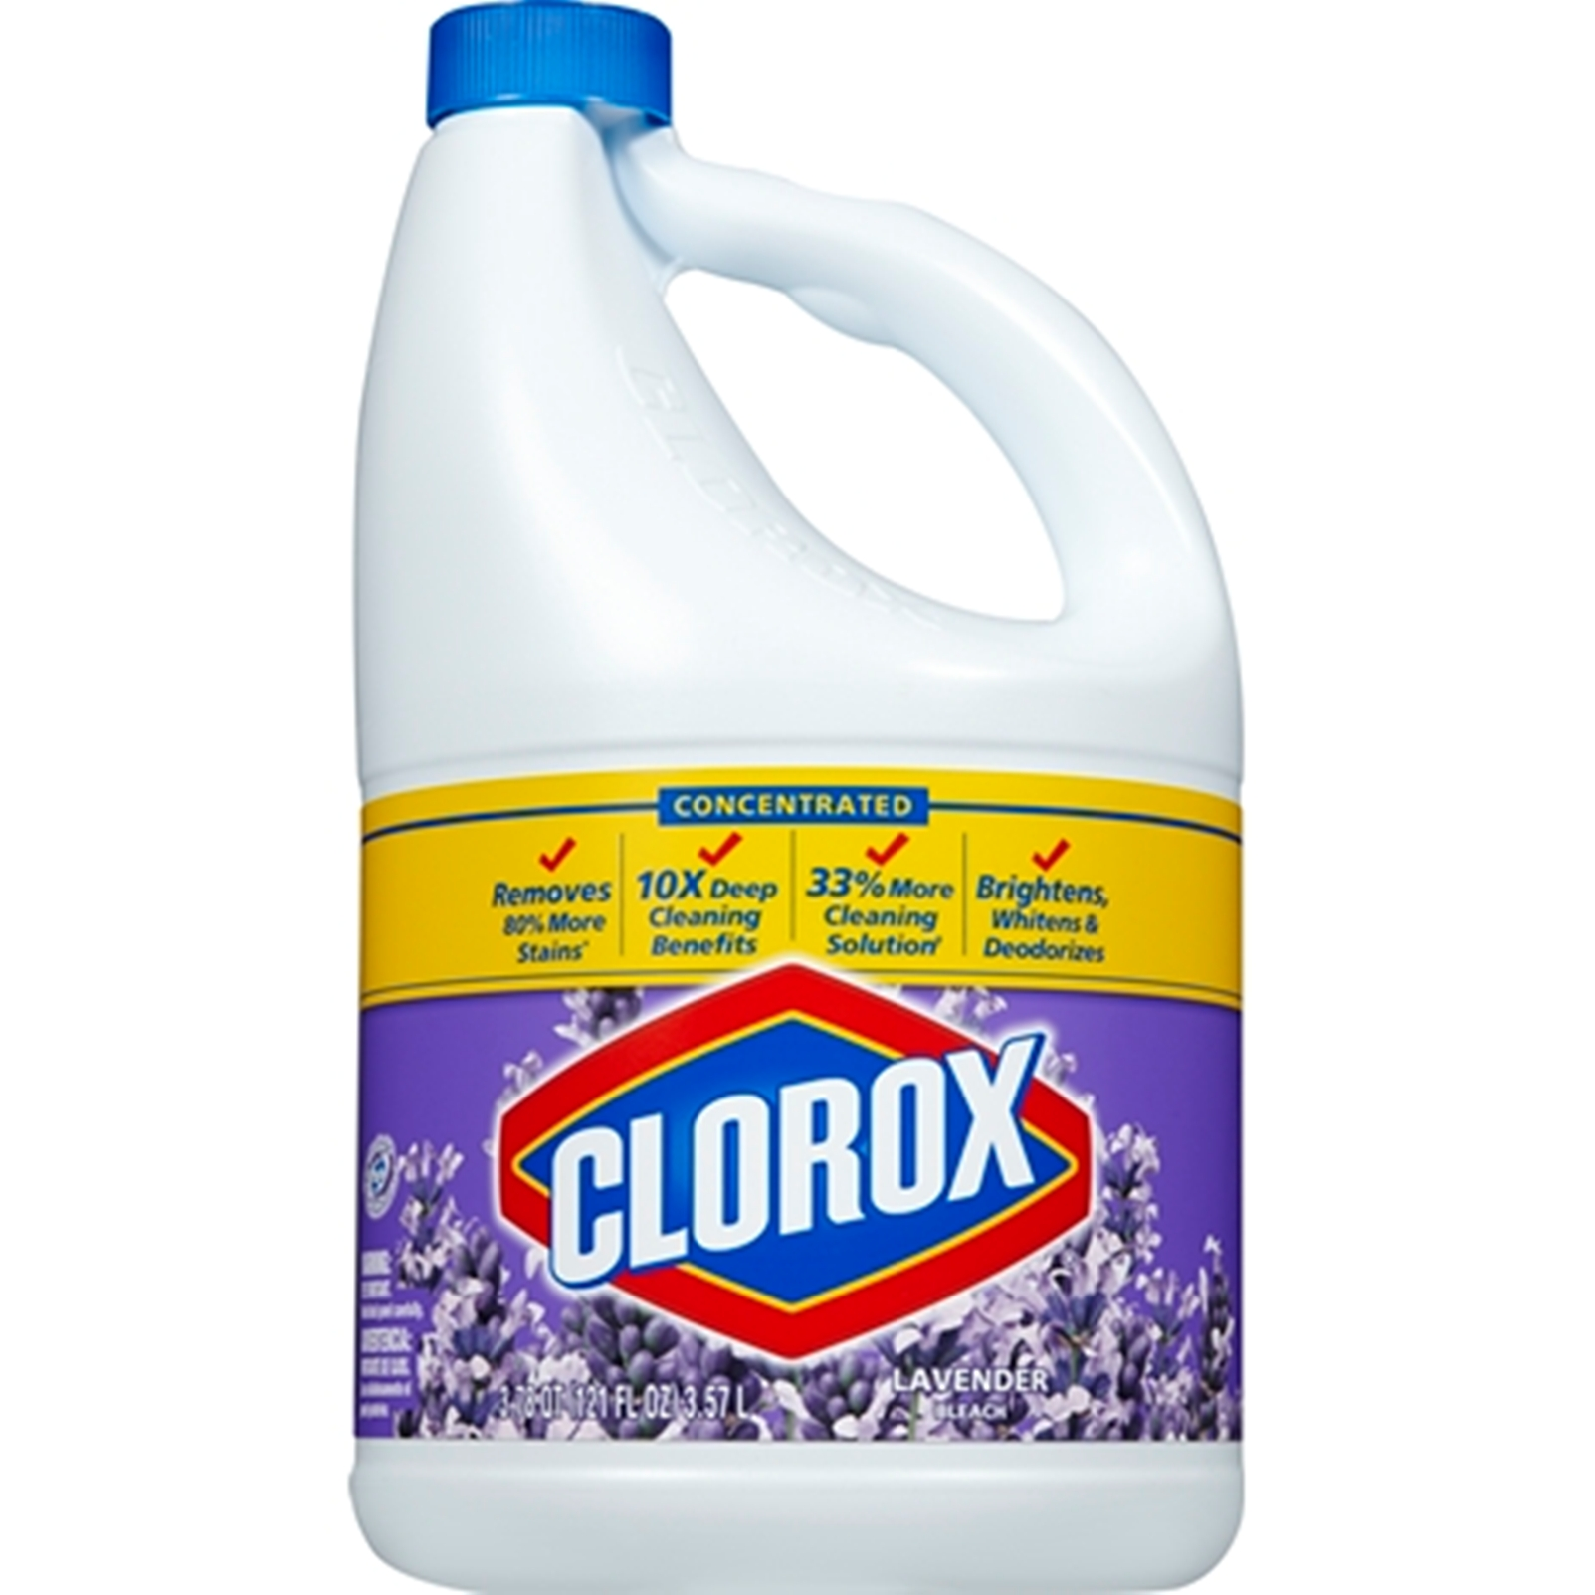


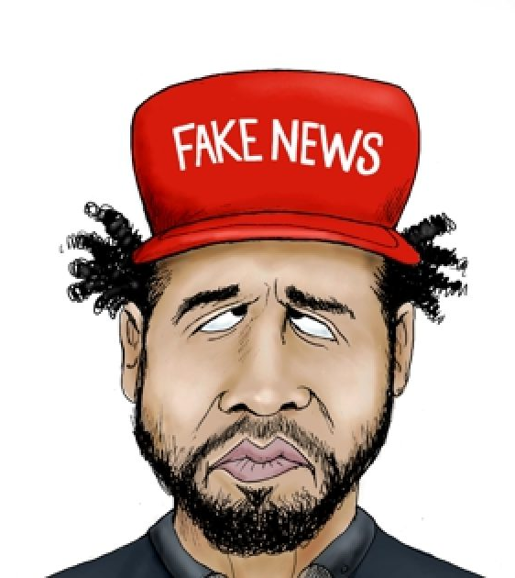
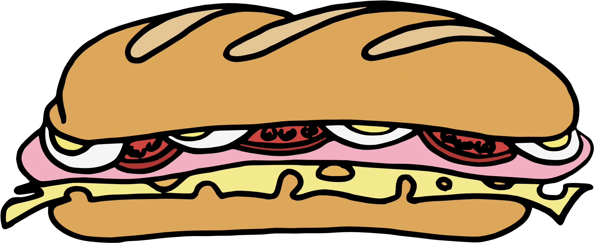

 | Juicy Course Designer: Kris Erickson (Based upon original story by Jussie Smollett) |  |  |  |  | Bay 2
SCENARIO: Walking back to your apartment after a sandwich run at 2 a.m. on a brisk Chicago morning, two pink pussy hat wearing "individuals" yell, "Hey! Aren't you that guy from the Redneck Comedy Tour!?”, put a rope around your neck, and are about to douse you with lavender-scented non-chlorine, eco-friendly fabric whitener. But these colors don’t run! Defend yourself and save your sandwich!
START POSITION: Standing at P1 facing downrange, rope around neck, sandwich in weak hand. Gun loaded, on carpet, safety on, pointed downrange. |  | STRINGS | CONCEALMENT |  | SCORING |  | TOTAL ROUNDS
 |  | 1 | REQUIRED |  | UNLIMITED |  | 6
STAGE PROCEDURE: Kneel on carpet, retrieve gun, and fire three rounds per target (at least one knee on ground), clutching sandwich in weak had for dear life. (Sandwich must be held in the weak hand for all shots.) (PCC may use both hands to hold rifle, but must have sandwich in weak hand for all shots.) |  | TARGETS |  | 2 threat.
 |  | SCORED HITS |  | Best 3 per target.
 |  | NOTES: Sandwich must be held in weak hand for all shots or Flagrant Penalty will be applied (5.0, 5.2.1). This is NOT a strong hand only stage. Pistol shooters may support pistol with weak hand.
P1
https://chicago.cbslocal.com/tag/jussie-smollett-hoax/

